Slide 1


Introduction to Machine Learning
Hossam Ahmed Salah
MSP Helwan

Slide 2



Agenda
What is Artificial intelligence(AI)?
AI application and subfields of AI
Machine Learning
AI tools and how to maximize your benefits from?
Set the environment

Slide 3

What is Artificial intelligence (AI)?
Intelligence
Artificial intelligence definition
Week AI vs Strong AI (Types based on ability)
Types of AI (based on functionalities)
Summary diagram

Slide 4
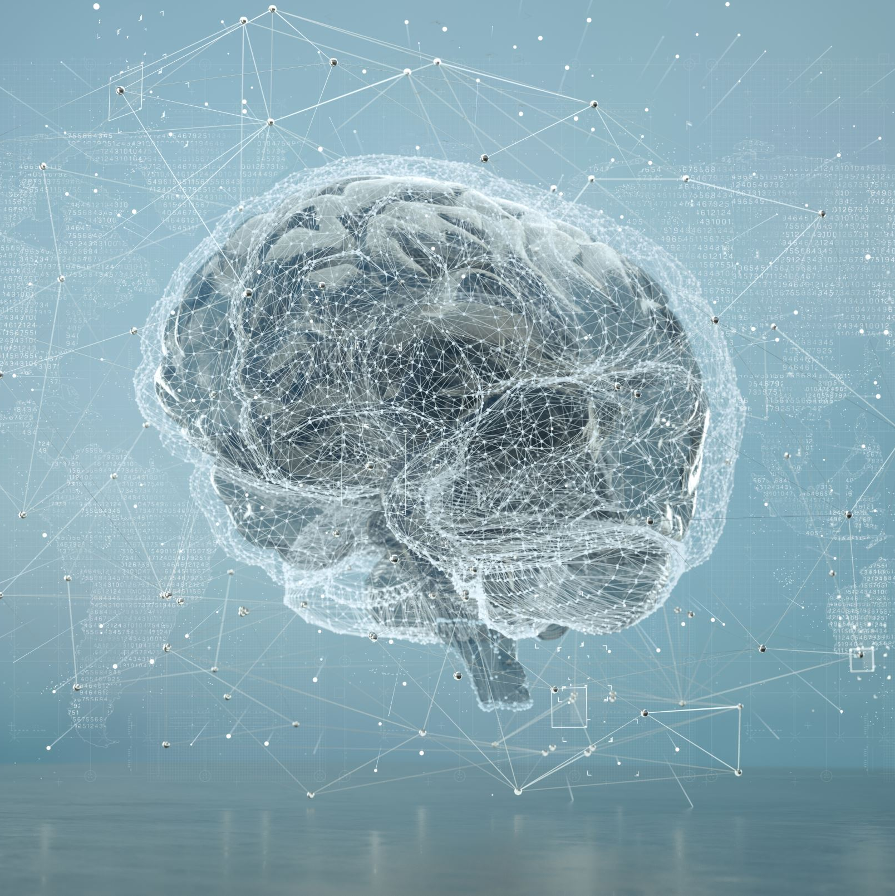
Intelligence
might be defined as the ability to learn and perform suitable techniques to solve problems and achieve goals

Slide 5

A fully pre-programmed factory robot can perform its tasks effectively, being adaptable, precise, and reliable.
However, this robot is not considered intelligent because it lacks the ability to learn or adapt on its own.
Intelligence extends beyond following instructions and includes the capacity to learn, adapt, and make decisions in various situations.

Slide 6
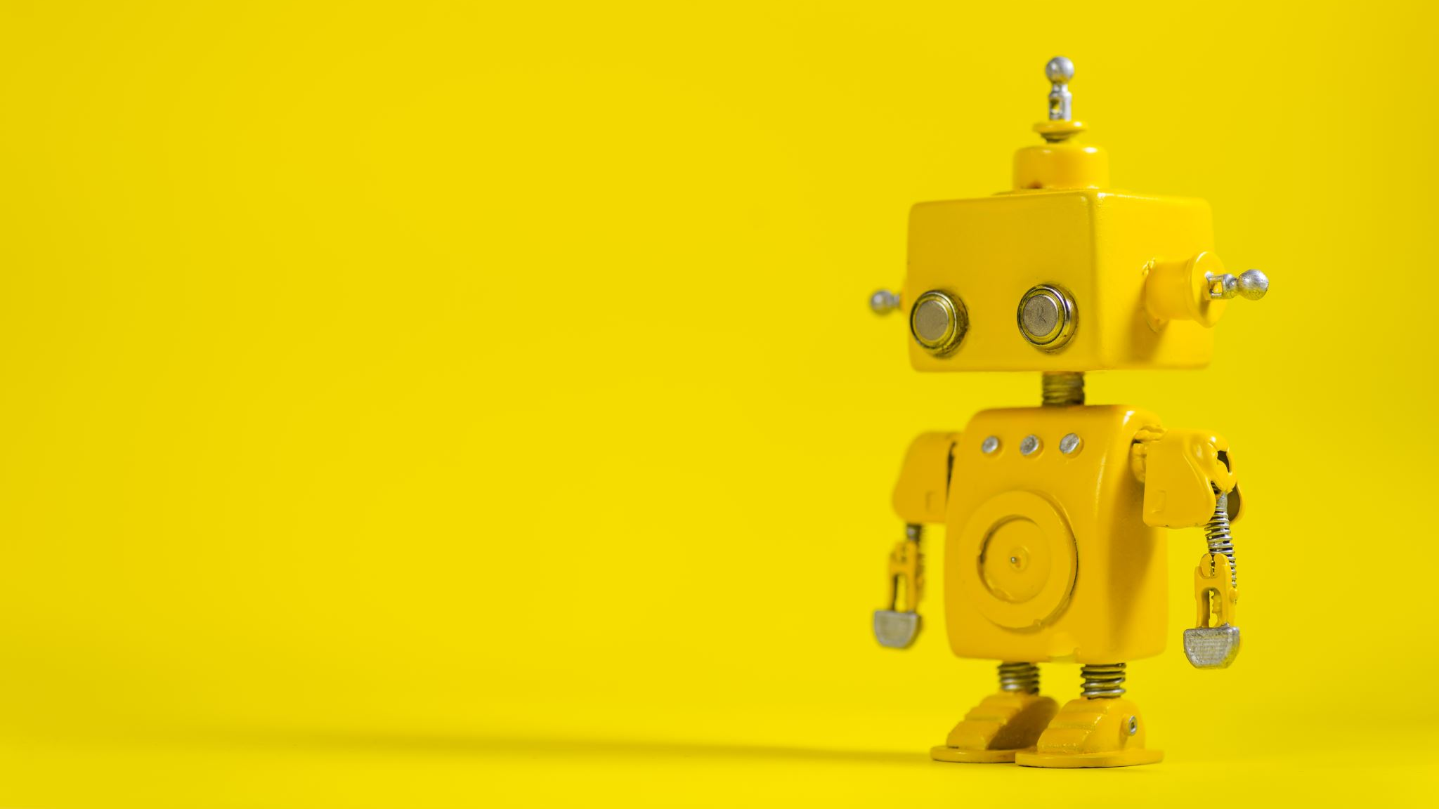
Artificial intelligence(AI)
the science and engineering of making intelligent machines “simulation of human intelligence”
AI is when a machine can do things that human minds can do, like perceiving(understanding), reasoning, learning, interacting with the world, solving problems, and being creative.

Slide 7
Weak AI
Weak AI refers to AI systems designed for specific tasks and lacks general intelligence.
Examples of weak AI include voice assistants, recommendation algorithms, image recognition systems ,Deep Blue, the chess-playing♟️ computer, and self-driving cars that use sensors to detect obstacles.
Weak AI excels at its designated functions but operates within predefined boundaries.
Weak AI cannot generalize beyond its specialized domain and is limited to the tasks it is programmed for.

Slide 8
Strong AI
Strong AI, also known as general AI, aims to possess human-level or superior intelligence across various tasks.
It would be capable of understanding, reasoning, learning, and solving complex problems like humans do.
However, the development of strong AI remains largely theoretical and has not been realized thus far

Slide 9
Types of AI
Based on functionalities
Purely reactive machines specialize in one field and do not have memory. They make decisions based on current observations, like in a chess game.
Limited memory machines collect and utilize previous data but have minimal memory capacity. They can make proper decisions, like suggesting a restaurant based on location data.
Machines with a theory of mind would understand thoughts, emotions, and social interactions, but such machines have not been created yet.
Self-aware machines, considered the future generation, will be intelligent, sentient, and conscious.

Slide 10
AI Types
Ability
Strong AI
Weak AI
Functionality
Purely reactive
Theory of mind
Limited memory
Self aware

Slide 11
AI applications and subfields of AI
AI applications
AI subfields

Slide 12
AI applications
Applications
Predictive maintenance
Predictive maintenance is crucial for industries relying on equipment.
It involves projecting when maintenance will be required to prevent breakdowns, minimize downtime, and reduce costs
Logistics optimization
AI can be utilized to optimize logistics and achieve cost reduction.
Real-time forecasts and behavioral coaching enabled by AI can contribute to cost reduction.
AI can optimize the routing of delivery traffic, leading to improved fuel efficiency and reduced delivery times.

Slide 13
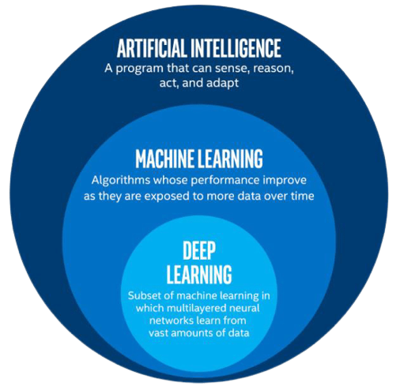
AI Subfields

Slide 14
AI
ML
DL
DATA SCIENCE
Math
Visualization
Statistics
Business

Slide 15


Slide 16

Machine Learning
Machine learning is a method of teaching computers to learn from data, without being explicitly programmed. It is a subset of artificial intelligence that involves the development of algorithms that can analyze and identify patterns in data, and use that knowledge to make decisions or predictions

Slide 17
Machine Learning
More about ML definition
ML lifecycle
Types of Machine Learning tasks
Data

Slide 18
A computer program is said to learn from experience E with respect to some task T and some performance measure P, if its performance on T, as measured by P, improves with experience E
—Tom Mitchell, 1997 “more formal mathematical definition”
More about ML definition
Learn from data and histories
Improve with experience
Iteratively enhance a model that can be used to predict outcomes of questions

Slide 19
ML lifecycle
Gathering data
Data preparation
Model building
Model Evaluation
Model deployment
Business objective
Exploratory data analysis

Slide 20
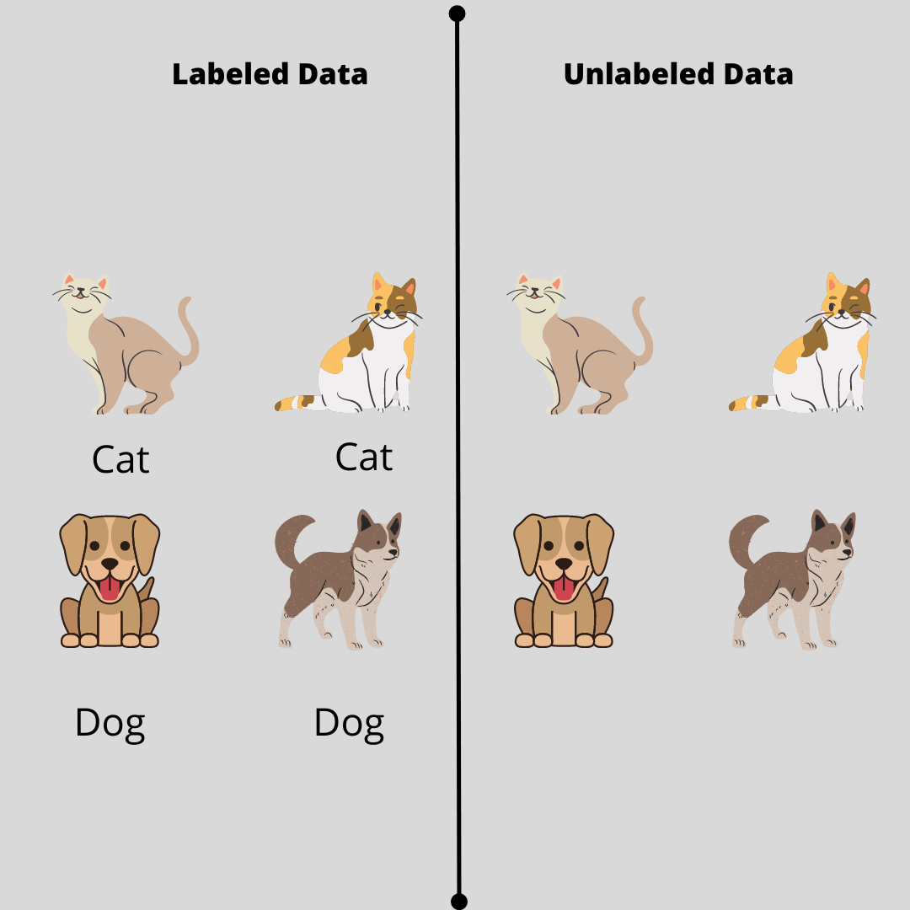
Data can be !
Labeled (Supervised)
Not labeled (Unsupervised)
ML task
Supervised
Classification
Regression
Unsupervised
Clustering
Reinforcement
Segmentation
Dimension reduction
Decision process
Reward system
Recommendation system
Types of ML tasks

Slide 21

Types of ML tasks supervised
Supervised
Classification
(sunny, cloudy,..)
Regression
(33º)

Slide 22
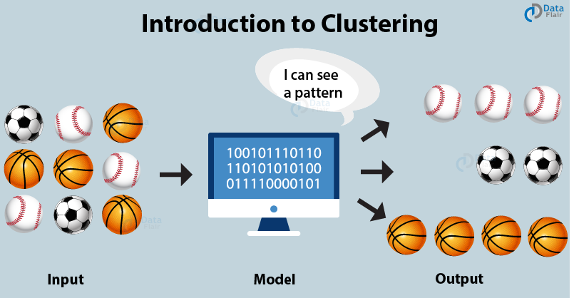

Unsupervised
Clustering
Segmentation
Dimension reduction
Types of ML tasks unsupervised

Slide 23
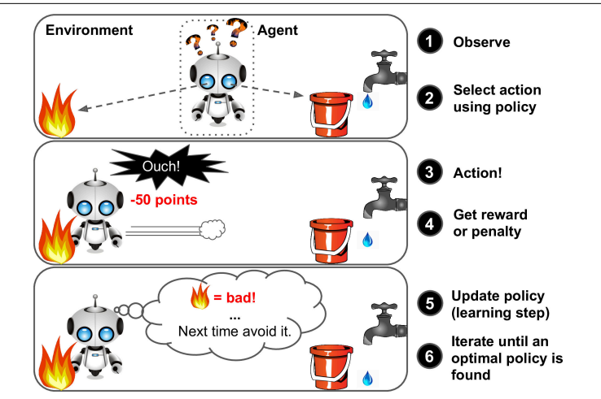
Reinforcement
Types of ML tasks Reinforcement

Slide 24
Data
Tabular
int
Float
images
Sound /Speech
Object (string)
Boolean
Text
Data types

Slide 25
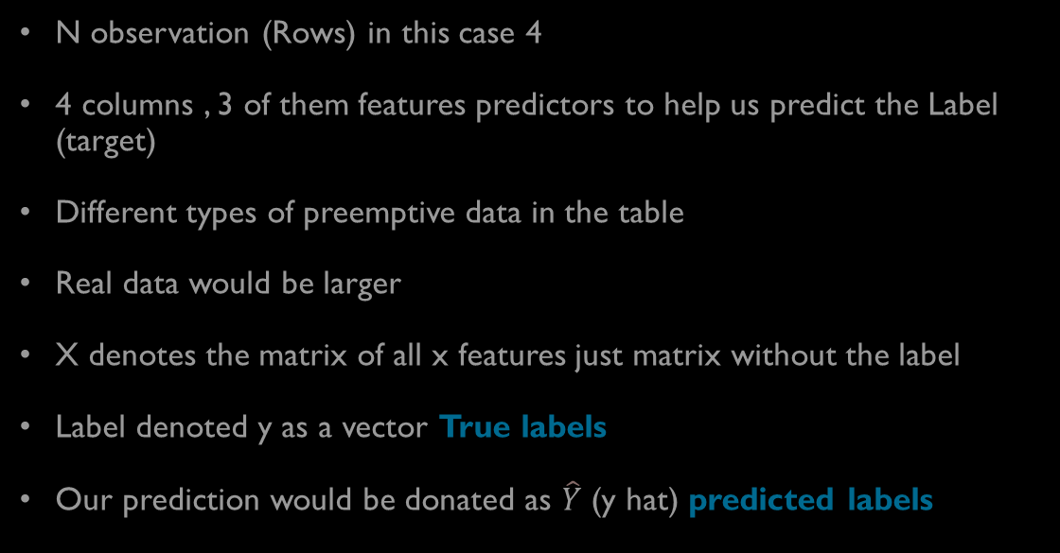
Data tabular
index | feature 1 | feature 2 | feature 3 | Label
0 | 4.5 | Practice | 1.7 | Yes
1 | 3.2 | Doesn’t | 4.4 | Yes
2 | 2.1 | Practice | 2.5 | No
3 | 4.5 | Practice | 1.7 | Yes
N observation (Rows) in this case 4
4 columns , 3 of them features predictors to help us predict the Label (target)
Different types of preemptive data in the table
Real data would be larger
X denotes the matrix of all x features just matrix without the label
Label denoted y as a vector True labels
Our prediction would be donated as $\hat{Y}$ (y hat) predicted labels

Slide 26
AI tools and How to maximize your benefits from?
ChatGPT
- Some useful extensions
OpenAI API

Slide 27




Best practices
https://platform.openai.com/docs/guides/gpt-best-practices/strategy-write-clear-instructions
Useful extensions
ChatGPT
Another way to use GPT if you don’t have OpenAI account
ChatGPT would access internet search result

Slide 28
Environment
Python
- Anaconda

Slide 29

Thank You

Slide 30
References
https://www.ibm.com/topics/artificial-intelligence
https://www.mckinsey.com/featured-insights/mckinsey-explainers/what-is-ai
https://hai.stanford.edu/sites/default/files/2020-09/AI-Definitions-HAI.pdf
https://www.simplilearn.com/tutorials/artificial-intelligence-tutorial/types-of-artificial-intelligence
https://www.precedenceresearch.com/artificial-intelligence-market
https://www.statista.com/statistics/1365145/artificial-intelligence-market-size/
https://youtu.be/zjeBGkS4LAA
https://www.javatpoint.com/machine-learning-life-cycle
An Introduction to Statistical Learning
java deep learning projects

